Slide 1

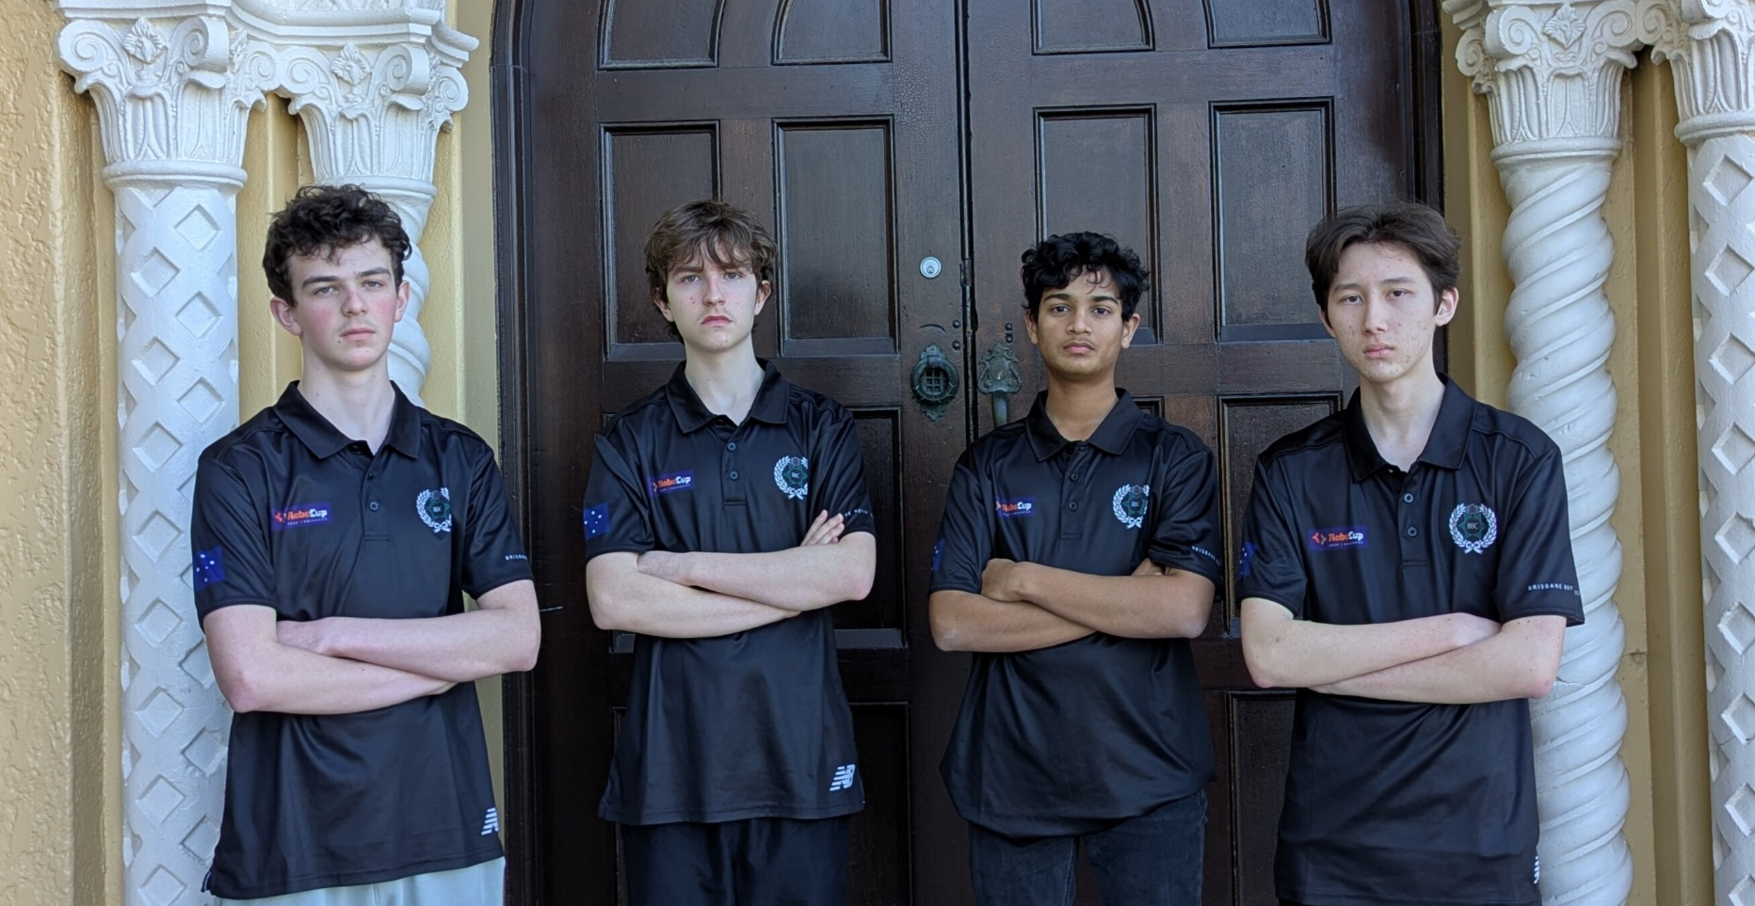
TEAM HYPERIOn
SAM GARG, MATTHEW ADAMS, LUKE ATHERTON AND THOMAS MCCABE

Slide 2
STRUCTURAL
Something something

Slide 3
Electrical
Something something

Slide 4
SOFTWARE | TSSP SYSTEM
Tom

Slide 5
SOFTWARE | TSSP SYSTEM
Tom

